Slide 1
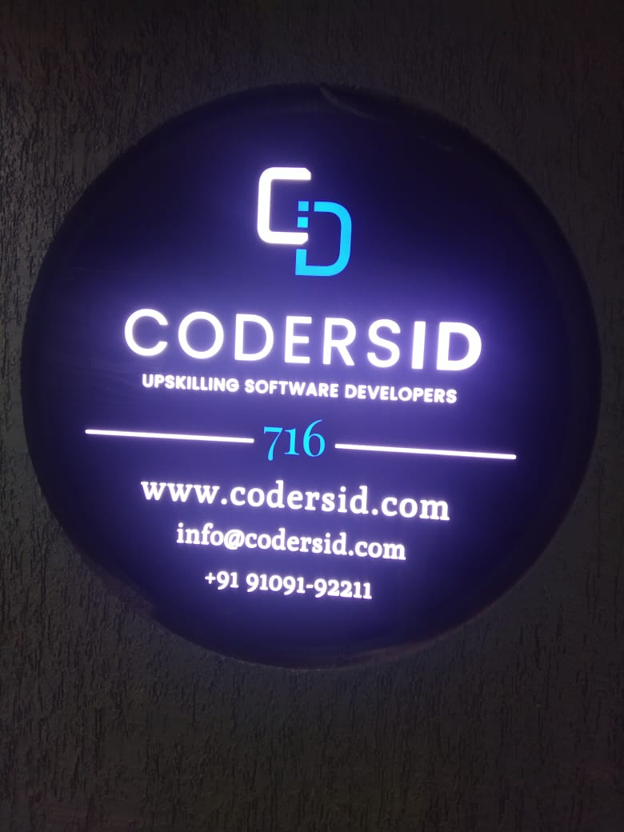
REVIEW AND RATING

Slide 2
About -
Requirement Gathering
Analysis
E-R-D
Create Virtual Environment
Required tools – Postman, VisualStudioCode, MongoDb, Node.js
Create Boiler Plate
MVC design pattern
Design schema and database
Write Business logic and funtions
Create Routes

